Slide 1
MONASH INFORMATION
TECHNOLOGY
Parallel Classification
Prajwol Sangat

Slide 2
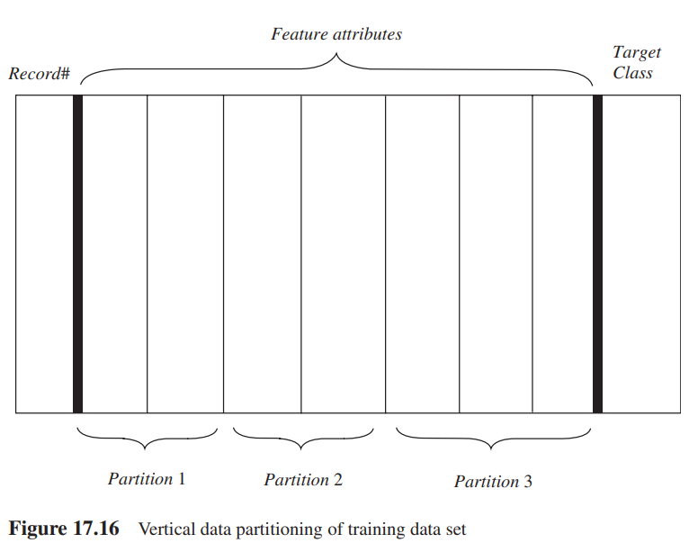
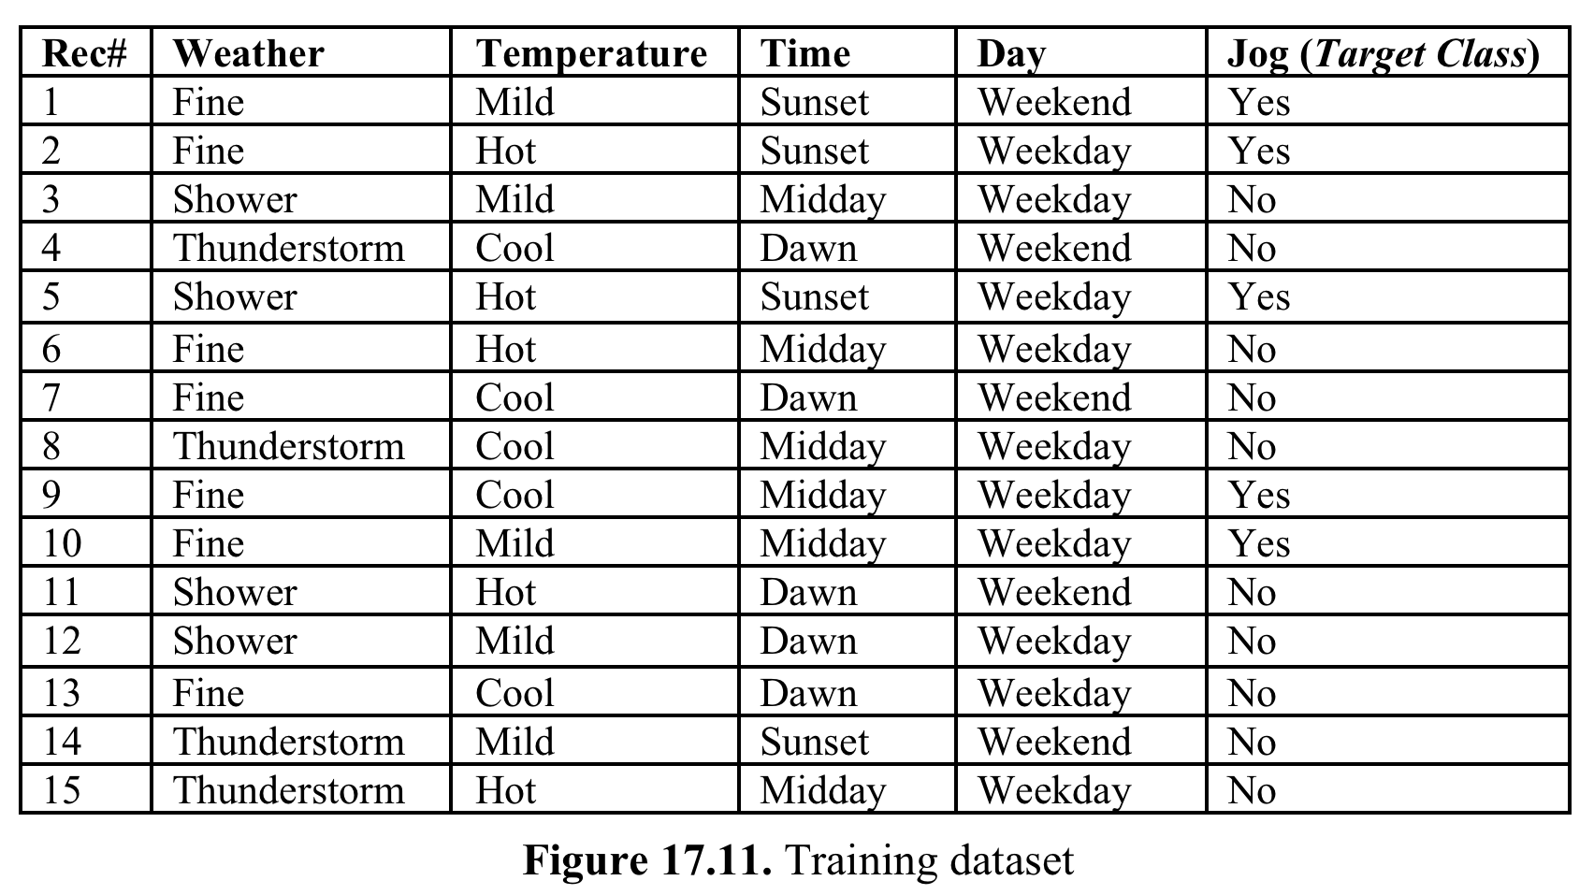
Parallel Classification: Decision Tree
Data parallelism

Slide 3
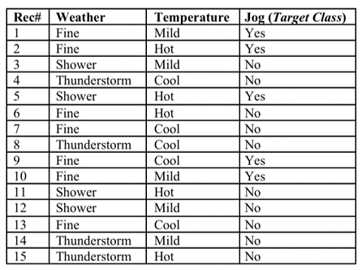
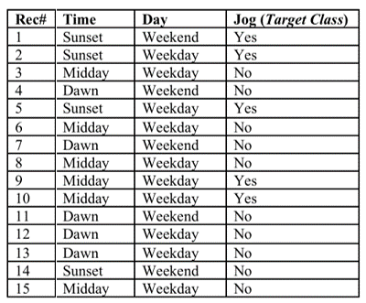
Parallel Classification: Decision Tree
Data parallelism: Vertical Partitioning of Training dataset
Partition 1
Partition 2

Slide 4
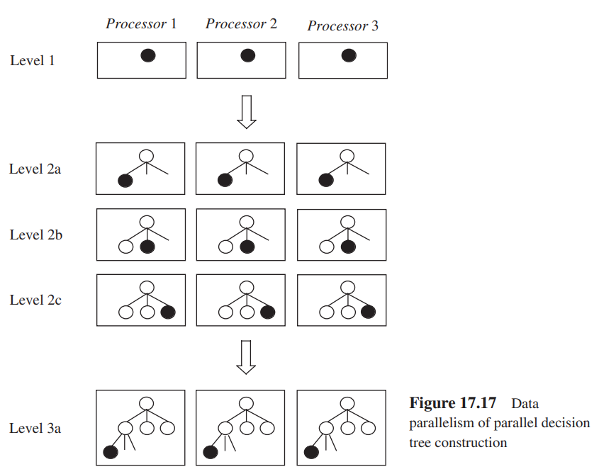
Parallel Classification: Decision Tree
Data parallelism

Slide 5
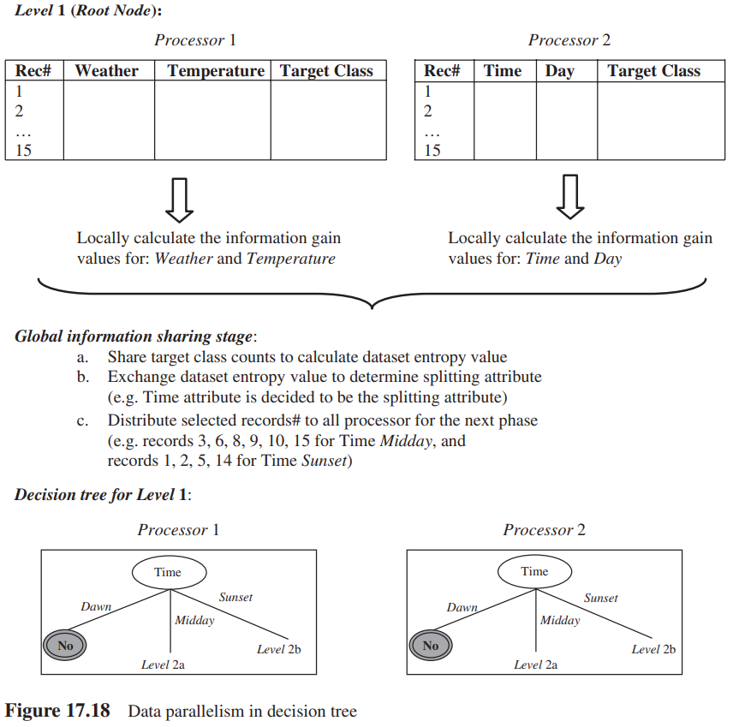
Parallel Classification: Decision Tree
Data parallelism

Slide 6
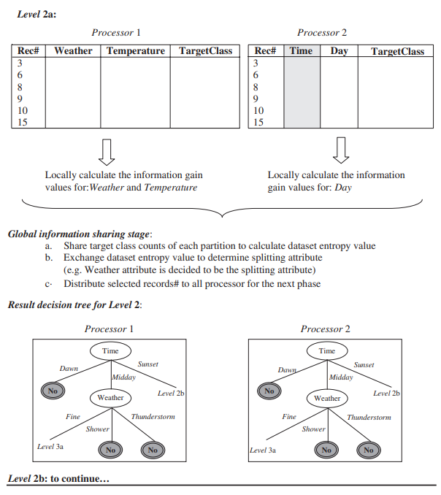
Parallel Classification: Decision Tree
Data parallelism

Slide 7
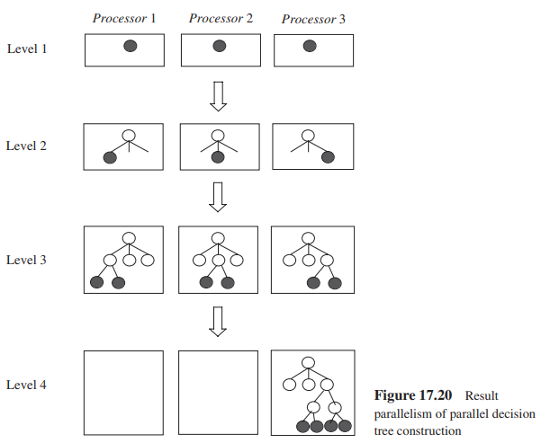
Parallel Classification: Decision Tree
Result parallelism

Slide 8
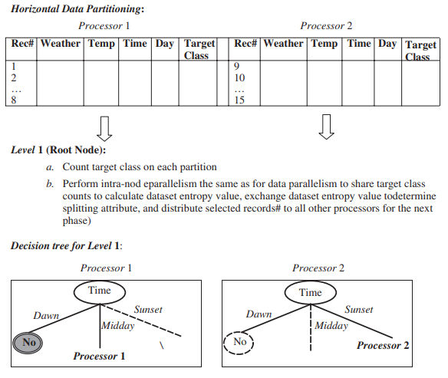
Parallel Classification: Decision Tree
Result parallelism

Slide 9
Parallel Classification: Decision Tree
 |  | Jog
 |  | Yes | No
Time | Dawn | 0 | 5 | 5
 | Midday | 2 | 4 | 6
 | Sunset | 3 | 1 | 4
 |  |  |  | 15
 |  | Jog
 |  | Yes | No
Day | Weekend | 4 | 6 | 10
 | Weekday | 1 | 4 | 5
 |  |  |  | 15
Result parallelism
Jog
Yes | No
5 | 10
 |  | Jog
 |  | Yes | No
Weather | Fine | 4 | 3 | 7
 | Shower | 1 | 3 | 4
 | Thunderstorm | 0 | 4 | 4
 |  |  |  | 15
 |  | Jog
 |  | Yes | No
Temperature | Hot | 2 | 3 | 5
 | Mild | 3 | 2 | 5
 | Cool | 1 | 4 | 5
 |  |  |  | 15

Slide 10
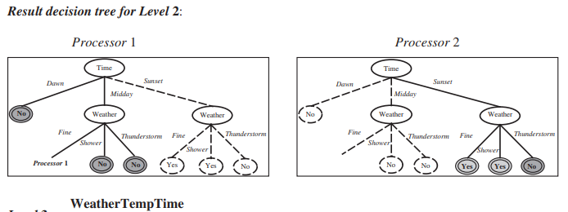
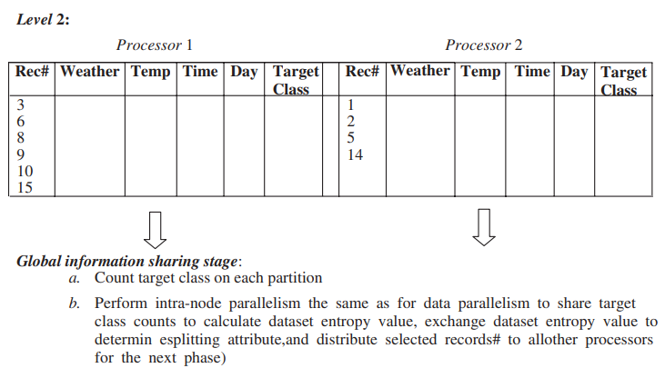
Parallel Classification: Decision Tree
Result parallelism

Slide 11
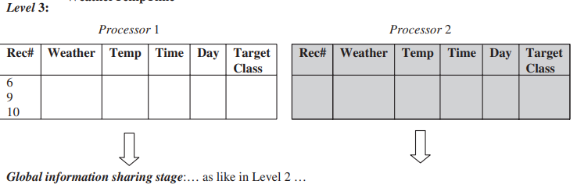
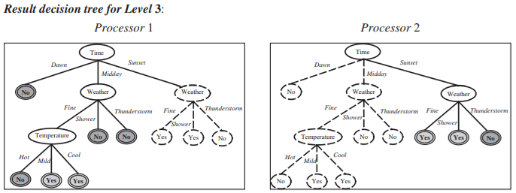
Parallel Classification: Decision Tree

Slide 12
See you next week..
Questions???

